Slide 1

INSTITUTE : UIE
DEPARTMENT : CSE
Bachelor of Engineering (Computer Science & Engineering)
WEB AND MOBILE SECURITY (Professional Elective-I)
(20CST/IT-333)
TOPIC OF PRESENTATION:
IOS, Android and Window phone Security Model
.
DISCOVER . LEARN . EMPOWER

Slide 2
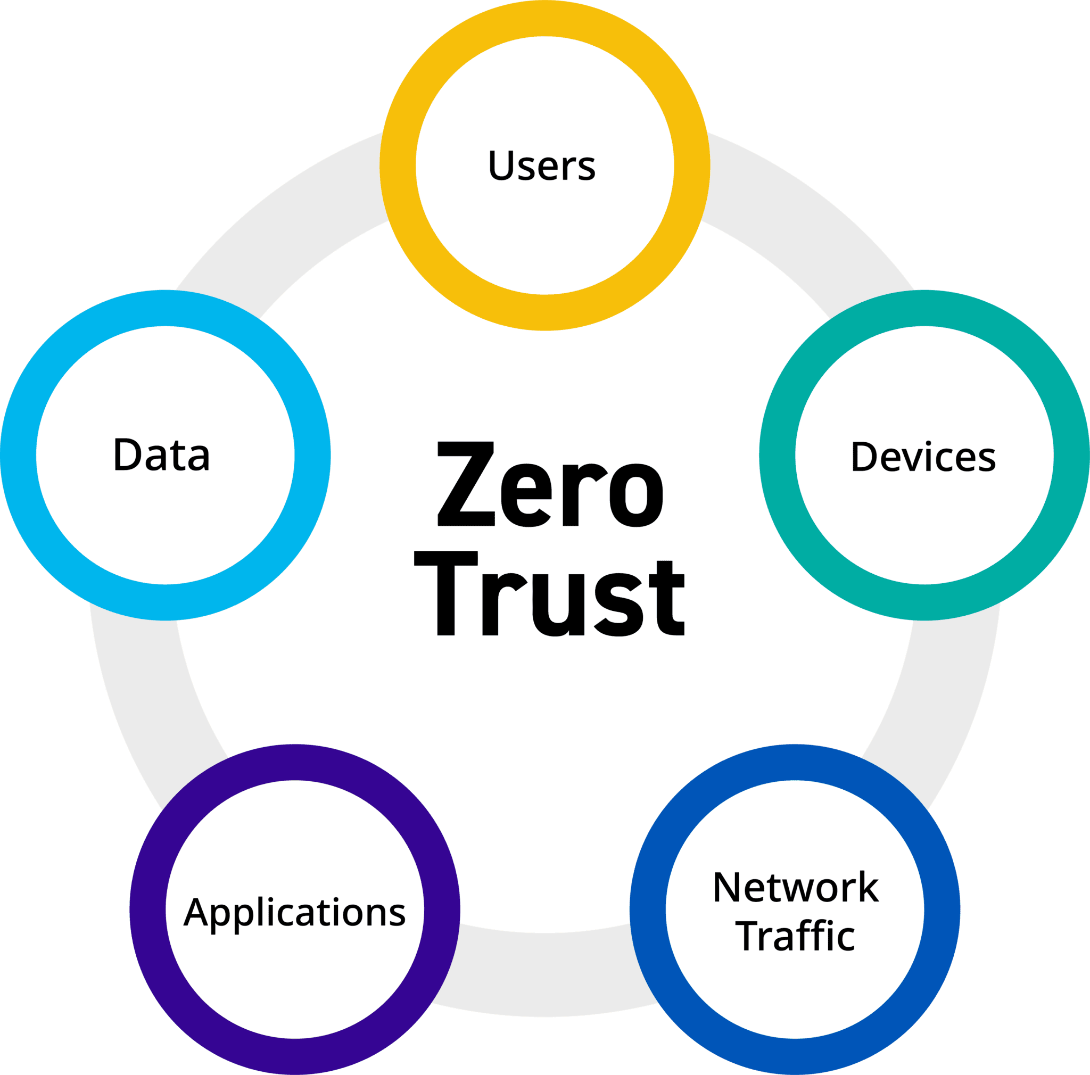
Lecture Objectives
In this lecture, we will discuss:
IOS, Android and Window phone Security Model

Slide 3
Introduction
Android (Google)
-a widely anticipated open source operating system for mobile devices
-it provide base operation system, application middleware layer, Java software development kit and a collection of system applications.
Feature of Android
Doesn’t support applications developed for other platforms
Restricts application interaction to its special APIs by running each application as its own user identity
Uses a simple permission label assignment model to restrict access to resources and other applications

Slide 4
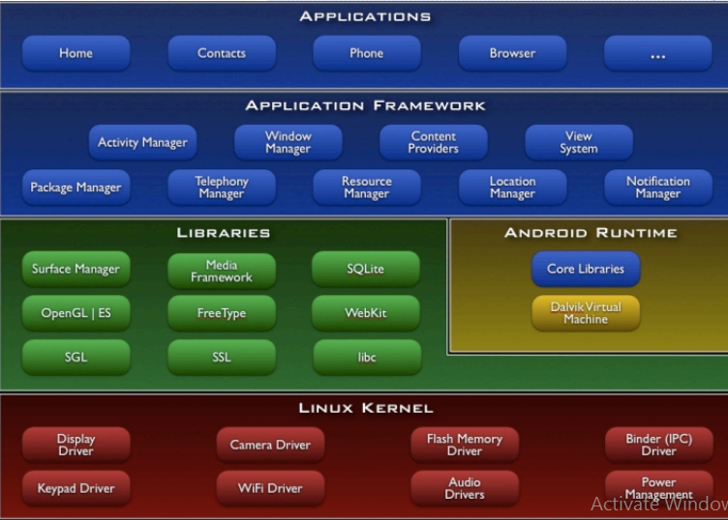

Slide 5
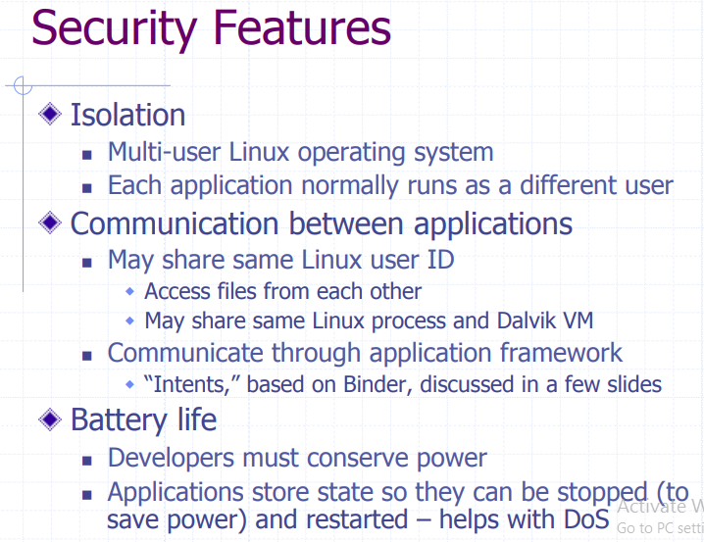

Slide 6
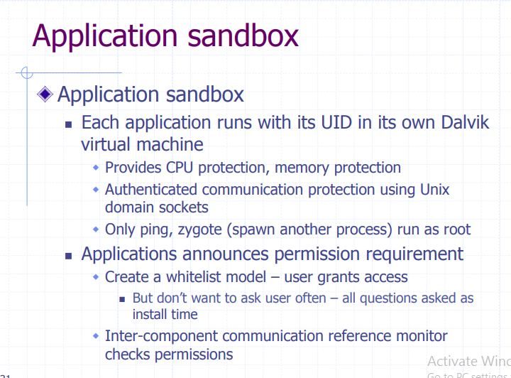

Slide 7
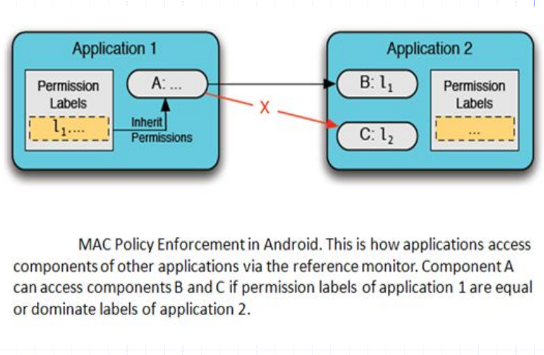

Slide 8
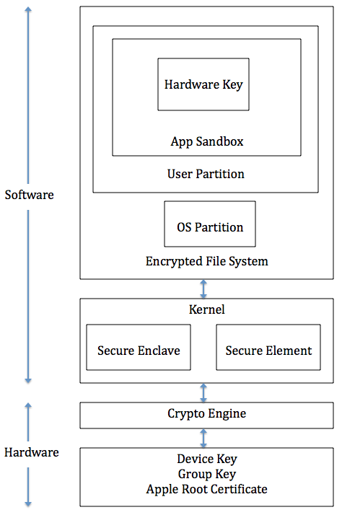
IOS

Slide 9
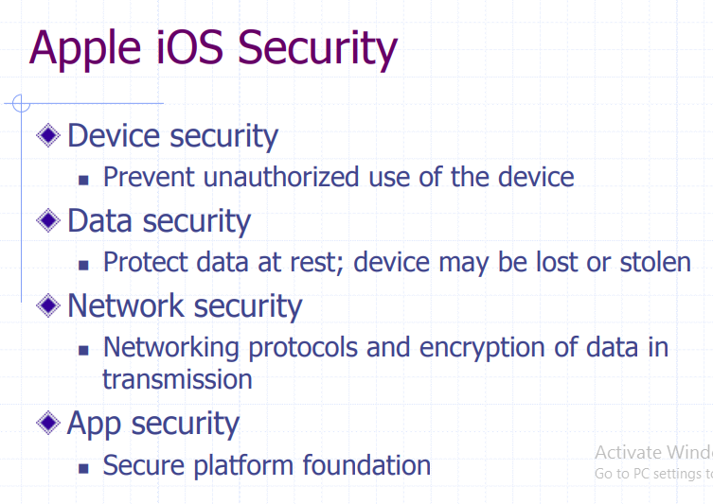
https://crypto.stanford.edu/cs155old/cs155-spring14/lectures/17-mobile-platforms.pdf

Slide 10
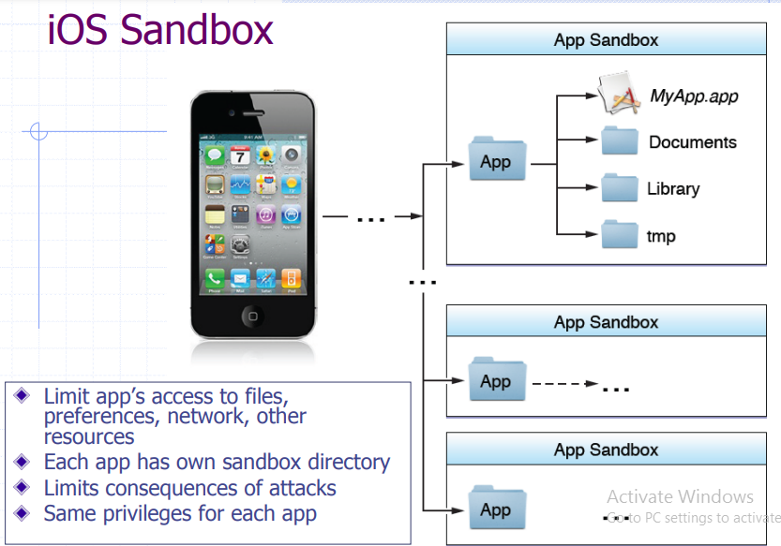

Slide 11
Secure booting process
During the booting process, iOS uses a mechanism called "secure boot chain" to ensure that the low-level software is not compromised and iOS is running on a validated iOS device. Each step in secure boot chain verifies if the next step of chain is valid and signed by Apple. The booting process will only proceed to the next step of chain if the verification succeeds.
When you turn on an iOS device, the processor first executes the code from Boot ROM (read-only-memory). The code in Boot ROM is created during chip fabrication, hence it is trusted and immutable. The code in Boot ROM also contains the Apple Root CA public key, which will be used to verify if Low-Level Bootloader (LLB) is signed by Apple. If LLB is valid, the processor will run the next-stage bootloader, iBoot, which will in turn verify and run the iOS kernel.

Slide 12
Secure Enclave
The Secure Enclave is a coprocessor for Apple’s A-series processor. It has its own secure boot separated from the application processor, communication between it and the application processor is highly encapsulated. Its tasks include key management, processing cryptographic operations and maintaining the data integrity.
Each Secure Enclave comes with a unique ID (UID) during the fabrication. Other parts of the system don’t have access to UID, neither does Apple. UID is used to encrypt the Secure Enclave’s memory space and data of files stored in the file system.
The Secure Enclave is also responsible for decrypting and processing the fingerprints received from the Touch ID, verifying if the coming fingerprints match the registered fingerprints. The application processor forwards the fingerprints data to the Secure Enclave. Because the fingerprints data is encrypted with a session key between the Secure Enclave and the Touch ID, the application processor can’t read it.

Slide 13
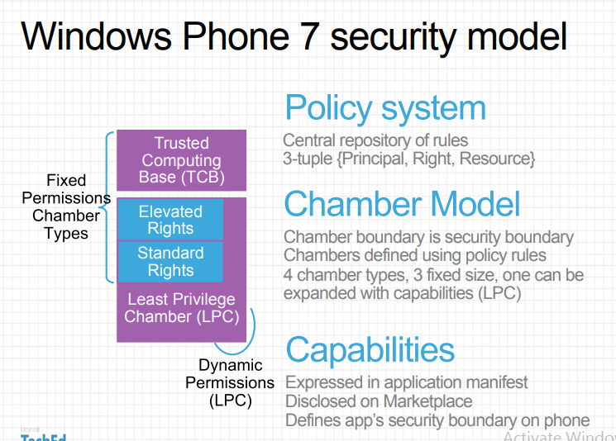

Slide 14
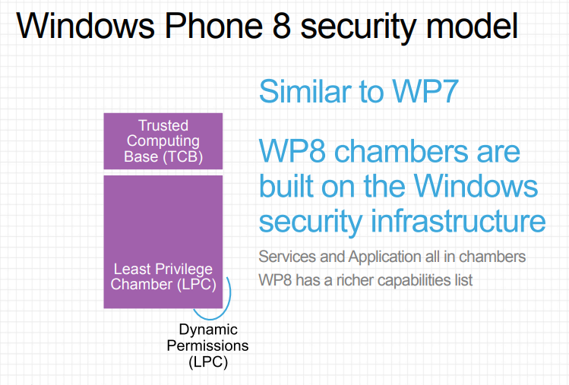

Slide 15
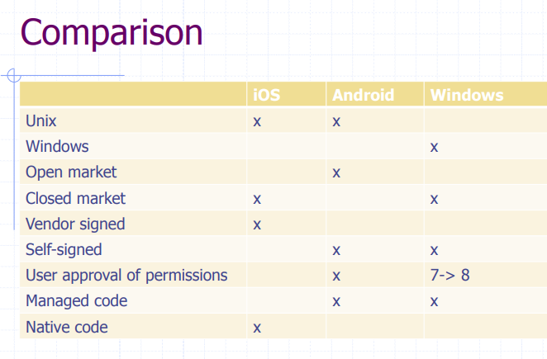

Slide 16
References:
Books:
Hacking Exposed Mobile: Security Secrets & Solutions 1st Edition, Kindle Edition, by Neil Bergman, Mike Stanfield, Jason Rouse, and Joel Scambray
Hacking Exposed Web Applications, 3rd edition, Joel Scambray, Vincent Liu, Caleb Sima, Released October 2010, Publisher(s): McGraw-Hill
Video Lectures :
1. https://www.kaspersky.com/resource-center/threats/android-vs-iphone-mobile-security
2. https://www.diffen.com/difference/Android_vs_iOS
Reference Links:
1. https://www.tutorialspoint.com/mobile_security/mobile_security_windows_phone_os.htm
2. https://logrhythm.com/solutions/security/zero-trust-security-model/
3. https://crypto.stanford.edu/cs155old/cs155-spring14/lectures/17-mobile-platforms.pdf

Slide 17
THANK YOU

